Slide 1



BUSINESS INSIGHTS 360 ATLIQ HARDWARE
BY: MAYUR V
LINK

Slide 2

HOME VIEW
01
Landing page of report. Acts as a central hub from where one can navigate to other views.
Power BI | Project | Business Insights 360 - AtliQ Hardware

Slide 3
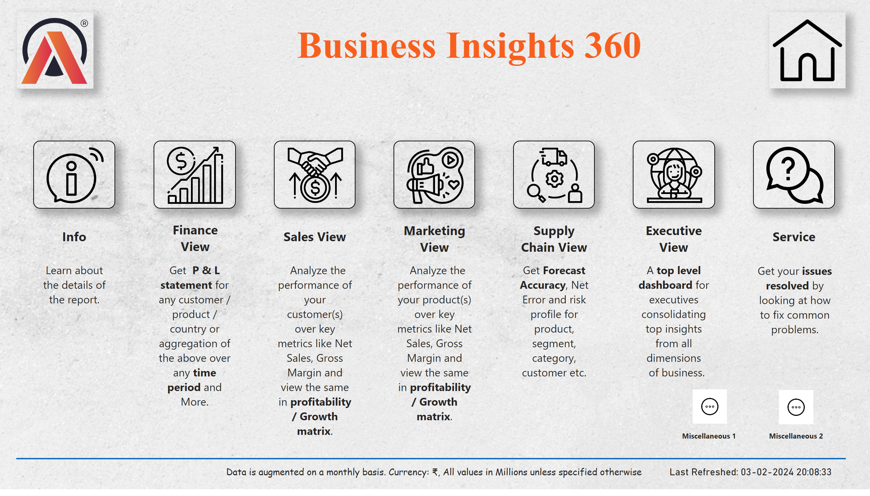
Home
Notes:
Image - Logo
No alt text provided
Text box - Title
No alt text provided
Image - Sales
No alt text provided
Image - Marketing
No alt text provided
Image - Finance
No alt text provided
Image - Executive
No alt text provided
Image - Support
No alt text provided
Image - Home
No alt text provided
Image - Info
No alt text provided
Image - Supply Chain
No alt text provided
textbox
No alt text provided
textbox
No alt text provided
textbox
No alt text provided
textbox
No alt text provided
textbox
No alt text provided
textbox
No alt text provided
textbox
No alt text provided
textbox
No alt text provided
textbox
No alt text provided
textbox
No alt text provided
textbox
No alt text provided
textbox
No alt text provided
textbox
No alt text provided
textbox
No alt text provided
textbox
No alt text provided
card
No alt text provided
shape
No alt text provided
image
No alt text provided
image
No alt text provided
textbox
No alt text provided
textbox
No alt text provided

Slide 4

FINANCE VIEW
02
P & L Statement.
Performance over Time.
Product and Market Ranking by Metrics.
Used for budgeting, financial reporting, strategic financial planning and assessing the financial health of company.
Power BI | Project | Business Insights 360 - AtliQ Hardware

Slide 5
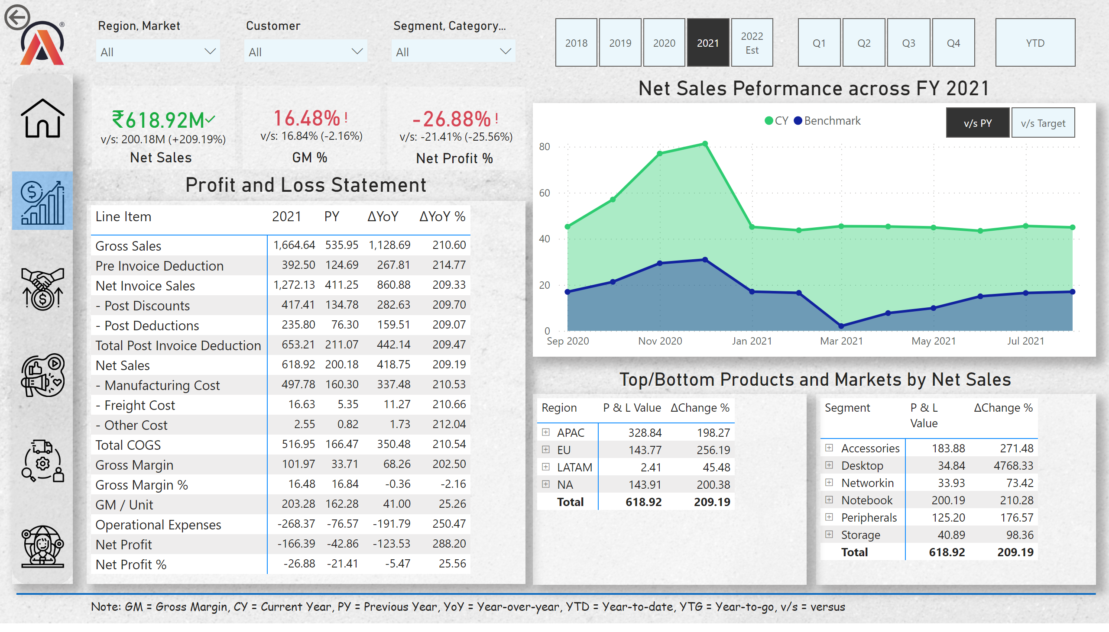
Finance View
Notes:
shape
No alt text provided
Card - Warning
No alt text provided
Card - Warning
No alt text provided
Card - Warning
No alt text provided
Card - Warning
No alt text provided
Benchmark
No alt text provided
Text box - Note
No alt text provided
Shape - Highlight Selection
No alt text provided
Image - Home
No alt text provided
Image - Supply Chain
No alt text provided
Image - Executive
No alt text provided
Image - Finance
No alt text provided
Image - Marketing
No alt text provided
Image - Sales
No alt text provided
shape
No alt text provided
Net Sales
No alt text provided
textbox
No alt text provided
Net Sales
No alt text provided
textbox
No alt text provided
Net Sales
No alt text provided
textbox
No alt text provided
Slicer - Segment, Category
No alt text provided
Slicer - Customer
No alt text provided
Slicer - Region, Market
No alt text provided
Text box - P & L
No alt text provided
card
No alt text provided
card
No alt text provided
Matrix - Top Markets
No alt text provided
Image - Logo
No alt text provided
actionButton
No alt text provided
Matrix - Top Products
No alt text provided
Performance Across FY
No alt text provided
Slicer - YTD, YTG
No alt text provided
Slicer - Quarters
No alt text provided
Matrix - P & L
No alt text provided
Slicer - FY Desc
No alt text provided

Slide 6
FINANCIAL/SALES REPORTING TERMS
Gross Sales
Pre-Invoice Deductions
Net Invoice Sales
Post-Invoice Deductions
01
02
The total revenue generated from sales before deducting any expenses.
Adjustments/reductions in price made to an invoice before it is officially issued to customer.
03
04
Gross Sales minus the pre-invoice deductions.
Adjustments/reductions in price made to an invoice after it is officially issued to customer.

Slide 7
FINANCIAL/SALES REPORTING TERMS
Net Sales
Total COGS
Gross Margin
Gross Margin %
05
06
Gross Margin minus the pre- and post-invoice deductions which include discounts, rebates etc.
Cost of Goods Sold. Direct costs associated with producing goods that a company sells. Like manufacturing, transportation etc.
07
08
Difference between Net Sales and Total COGS. Indicates profitability.
Percentage of Gross Margin relative to Net Sales.

Slide 8
FINANCIAL/SALES REPORTING TERMS
Gross Margin / Unit
Operational Expenses
Net Profit
Net Profit %
09
10
Helps assess profitability of each unit sold. Robust indicator of product profitability.
Costs incurred in marketing and advertising the products, salaries, utilities etc.
11
12
Total profit after deducting all expenses from revenue. Indicates overall profitability.
Percentage of Net Profit relative to Net Sales.

Slide 9

SALES VIEW
03
Customer Sales Performance.
Market Performance Matrix – GM% v/s NS.
NS – GM Conversion. Unit Economics.
Product-wise Analysis.
Used by Sales team to engage with customers, build relationships and drive revenue.
Power BI | Project | Business Insights 360 - AtliQ Hardware

Slide 10
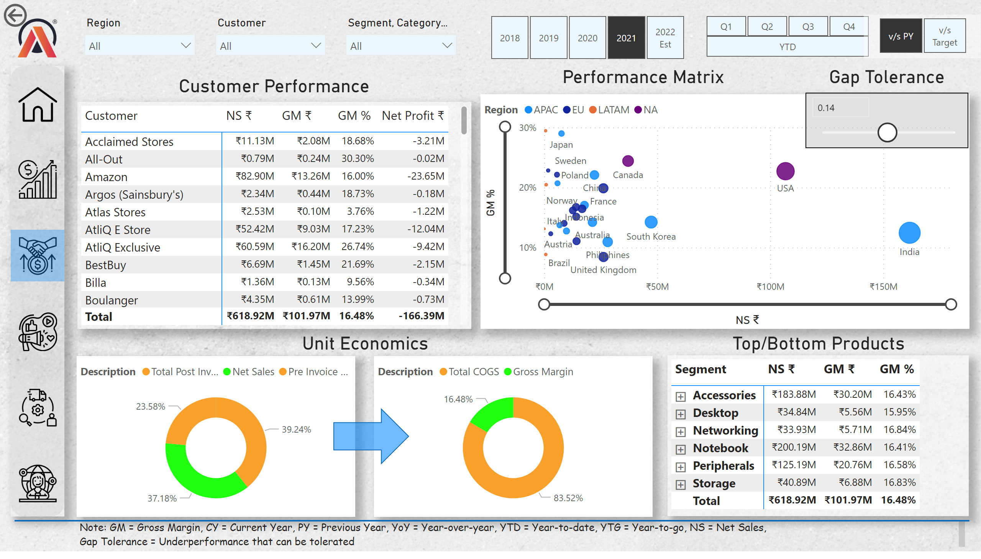
Sales View
Notes:
Matrix - Customer Peformance
No alt text provided
actionButton
No alt text provided
Image - Logo
No alt text provided
Text box - Customer Performance
No alt text provided
Slicer - Region
No alt text provided
Slicer - Customer
No alt text provided
Slicer - Segment, Category
No alt text provided
shape
No alt text provided
Image - Sales
No alt text provided
Image - Marketing
No alt text provided
Image - Finance
No alt text provided
Image - Executive
No alt text provided
Image - Supply Chain
No alt text provided
Image - Home
No alt text provided
Shape - Highlight
No alt text provided
Text box - Note
No alt text provided
Net Sales Proportion
No alt text provided
NS - GM Conversion
No alt text provided
Shape - Arrow
No alt text provided
Matrix - Top Products
No alt text provided
Text box - Unit Economics
No alt text provided
GM % v/s NS ₹
No alt text provided
Text box - Performance Matrix
No alt text provided
Text box - Top Products
No alt text provided
Gap Tolerance
No alt text provided
Text box - Gap Tolerance
No alt text provided
shape
No alt text provided
Slicer - FY Desc
No alt text provided
Slicer - YTD, YTG
No alt text provided
Slicer - Quarters
No alt text provided
Benchmark
No alt text provided

Slide 11

MARKETING VIEW
04
Product Sales Performance.
Product Performance Matrix – Net Profit % v/s NS.
GM – Net Profit Conversion. Unit Economics.
Region, Market-wise Analysis.
Used by Marketing team to develop and execute strategies, create brand awareness and drive demand.
Power BI | Project | Business Insights 360 - AtliQ Hardware

Slide 12
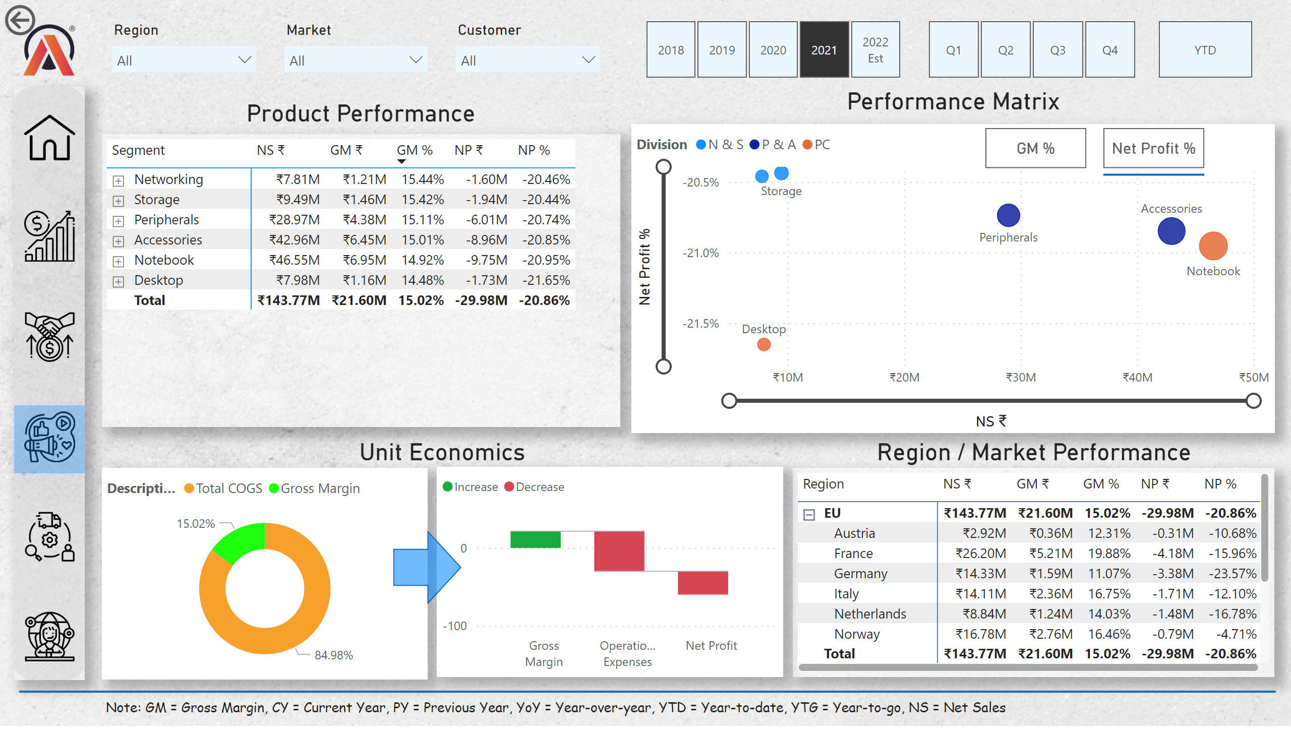
Marketing View
Notes:
Matrix - Product Performance
No alt text provided
actionButton
No alt text provided
Image - Logo
No alt text provided
Text box - Product Performance
No alt text provided
Slicer - Region
No alt text provided
Slicer - Market
No alt text provided
Slicer - Customer
No alt text provided
shape
No alt text provided
Image - Sales
No alt text provided
Image - Marketing
No alt text provided
Image - Finance
No alt text provided
Image - Executive
No alt text provided
Image - Supply Chain
No alt text provided
Image - Home
No alt text provided
Shape - Highlighter
No alt text provided
Text box - Note
No alt text provided
Gross Margin Proportion
No alt text provided
Shape - Arrow
No alt text provided
Text box - Unit Economics
No alt text provided
scatterChart
No alt text provided
Text box - Performance Matrix
No alt text provided
Text box - Region/Market Performance
No alt text provided
GM - NP Conversion
No alt text provided
Matrix - Region/Market Performance
No alt text provided
NP % v/s NS
No alt text provided
Button - GM %
No alt text provided
Button - Net Profit %
No alt text provided
shape
No alt text provided
Line - Net Profit %
No alt text provided
Slicer - FY Desc
No alt text provided
Slicer - Quarters
No alt text provided
Slicer - YTD, YTG
No alt text provided
shape
No alt text provided

Slide 13

SUPPLY CHAIN VIEW
05
Forecast Accuracy, Absolute Error, Net Error, Risk.
Customer-wise Key Metrics.
Accuracy – Net Error Trend.
Product-wise Key Metrics.
Helps Supply Chain team in logistics, inventory management and coordination with customers.
Power BI | Project | Business Insights 360 - AtliQ Hardware

Slide 14
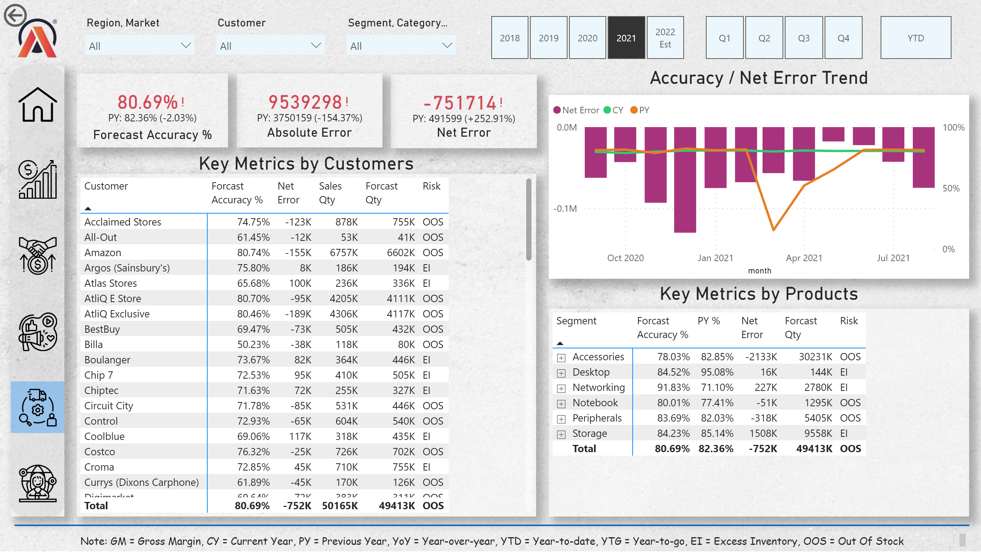
Supply Chain View
Notes:
actionButton
No alt text provided
Image - Logo
No alt text provided
Text box - Key Metrics Customers
No alt text provided
Slicer - Region, Market
No alt text provided
Slicer - Customer
No alt text provided
Slicer - Segment, Category
No alt text provided
textbox
No alt text provided
Net Sales
No alt text provided
textbox
No alt text provided
Net Sales
No alt text provided
textbox
No alt text provided
Net Sales
No alt text provided
shape
No alt text provided
Image - Sales
No alt text provided
Image - Marketing
No alt text provided
Image - Finance
No alt text provided
Image - Executive
No alt text provided
Image - Home
No alt text provided
Shape - Highlighter
No alt text provided
Text box - Note
No alt text provided
Matrix - Key Metrics Customers
No alt text provided
Accuracy / Net Error Trend
No alt text provided
Text box - Accuracy / Net Error Trend
No alt text provided
Matrix - Products Key Metrics
No alt text provided
Image - Supply Chain
No alt text provided
Text box - Products Key Metrics
No alt text provided
Slicer - FY Desc
No alt text provided
Slicer - Quarters
No alt text provided
Slicer - YTD, YTG
No alt text provided
shape
No alt text provided

Slide 15

EXECUTIVE VIEW
06
Key Metrics Over Time.
Key Insights by Sub-zones
AtliQ Market Share Over Time.
Revenue across Channels, Divisions.
Top 5 Products & Customers across Top 5 Markets.
Used by C-Suite Executives to get an overview of operations and aid in data-driven decision making.
Power BI | Project | Business Insights 360 - AtliQ Hardware

Slide 16
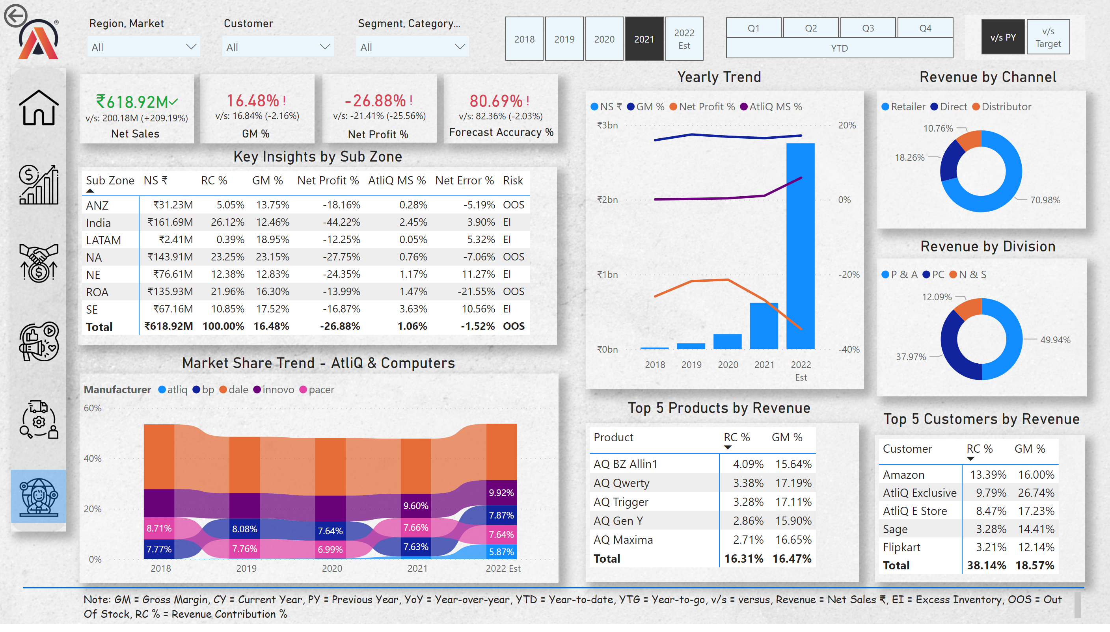
Executive View
Notes:
Slicer - FY Desc
No alt text provided
Matrix - P & L
No alt text provided
Slicer - Quarters
No alt text provided
Slicer - YTD, YTG
No alt text provided
Matrix - Top Products
No alt text provided
actionButton
No alt text provided
Image - Logo
No alt text provided
Matrix - Top Markets
No alt text provided
Text box - P & L
No alt text provided
Slicer - Region, Market
No alt text provided
Slicer - Customer
No alt text provided
Slicer - Segment, Category
No alt text provided
textbox
No alt text provided
Net Sales
No alt text provided
textbox
No alt text provided
Net Sales
No alt text provided
textbox
No alt text provided
Net Sales
No alt text provided
shape
No alt text provided
Image - Sales
No alt text provided
Image - Marketing
No alt text provided
Image - Finance
No alt text provided
Image - Executive
No alt text provided
Image - Supply Chain
No alt text provided
Image - Home
No alt text provided
Shape - Highlight Selection
No alt text provided
Text box - Note
No alt text provided
Benchmark
No alt text provided
Card - Warning
No alt text provided
donutChart
No alt text provided
donutChart
No alt text provided
textbox
No alt text provided
Net Sales
No alt text provided
Market Share %
No alt text provided
Text box - P & L
No alt text provided
lineClusteredColumnComboChart
No alt text provided
Text box - P & L
No alt text provided
Text box - P & L
No alt text provided
Text box - P & L
No alt text provided
Text box - P & L
No alt text provided
Text box - P & L
No alt text provided
shape
No alt text provided

Slide 17
MISCELLANEOUS 1
07
Customer Performance Tracking.
Performance Over Fiscal Year.
Key Metrics across Customers.
Based on specific feature requests.
Power BI | Project | Business Insights 360 - AtliQ Hardware

Slide 18
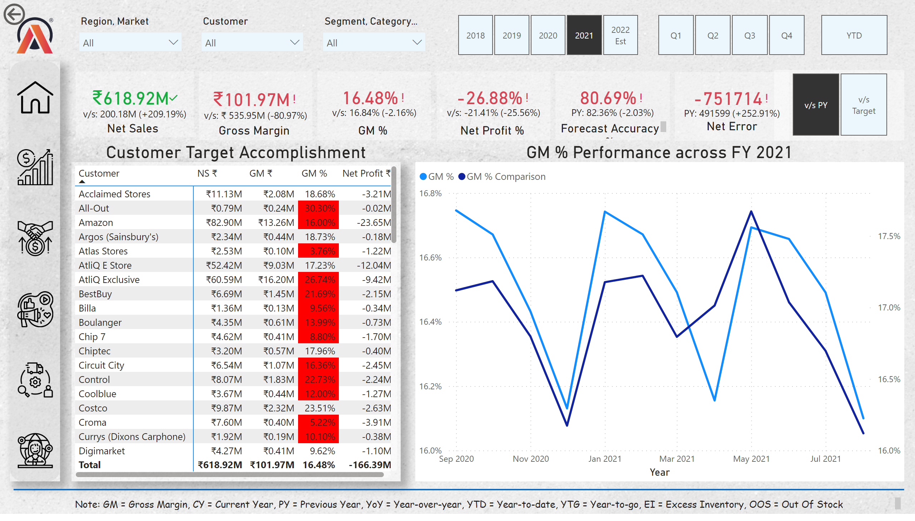
Miscellaneous 1
Notes:
actionButton
No alt text provided
Image - Logo
No alt text provided
Text box - Key Metrics Customers
No alt text provided
Slicer - Region, Market
No alt text provided
Slicer - Customer
No alt text provided
Slicer - Segment, Category
No alt text provided
shape
No alt text provided
Image - Sales
No alt text provided
Image - Marketing
No alt text provided
Image - Finance
No alt text provided
Image - Executive
No alt text provided
Image - Home
No alt text provided
Text box - Note
No alt text provided
Image - Supply Chain
No alt text provided
Slicer - FY Desc
No alt text provided
Slicer - Quarters
No alt text provided
Slicer - YTD, YTG
No alt text provided
shape
No alt text provided
Matrix - Key Metrics Customers
No alt text provided
GM % Performance across FY 2021
No alt text provided
Benchmark
No alt text provided
textbox
No alt text provided
Net Sales
No alt text provided
textbox
No alt text provided
Net Sales
No alt text provided
textbox
No alt text provided
Net Sales
No alt text provided
textbox
No alt text provided
Net Sales
No alt text provided
card
No alt text provided
textbox
No alt text provided
Net Sales
No alt text provided
textbox
No alt text provided
Net Sales
No alt text provided

Slide 19
MISCELLANEOUS 2
08
Top 5 Markets/Countries Metrics.
Top 5 Products.
Top 5 Customers.
Based on specific feature requests.
Power BI | Project | Business Insights 360 - AtliQ Hardware

Slide 20
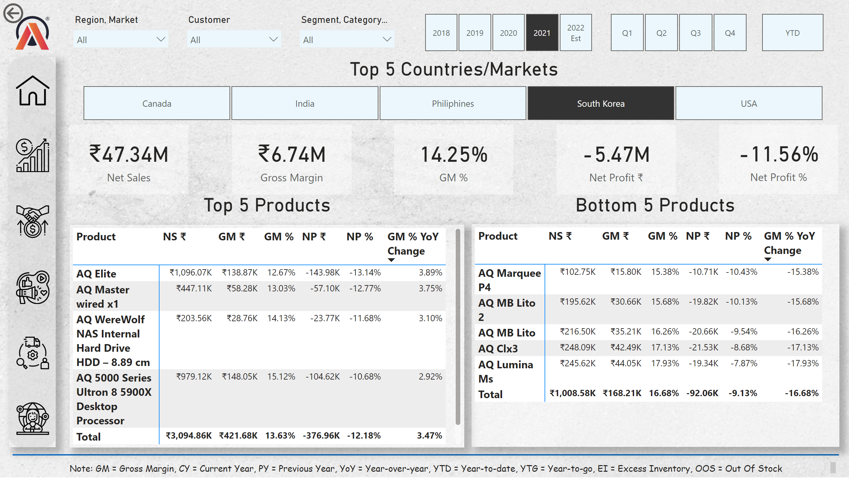
Miscellaneous 2
Notes:
actionButton
No alt text provided
Image - Logo
No alt text provided
Slicer - Region, Market
No alt text provided
Slicer - Customer
No alt text provided
Slicer - Segment, Category
No alt text provided
shape
No alt text provided
Image - Sales
No alt text provided
Image - Marketing
No alt text provided
Image - Finance
No alt text provided
Image - Executive
No alt text provided
Image - Home
No alt text provided
Text box - Note
No alt text provided
Image - Supply Chain
No alt text provided
Slicer - FY Desc
No alt text provided
Slicer - Quarters
No alt text provided
Slicer - YTD, YTG
No alt text provided
shape
No alt text provided
Matrix - Top 5 YoY
No alt text provided
slicer
No alt text provided
Matrix - Bottom 5 YoY%
No alt text provided
card
No alt text provided
card
No alt text provided
card
No alt text provided
card
No alt text provided
card
No alt text provided
textbox
No alt text provided
textbox
No alt text provided
textbox
No alt text provided

Slide 21
END RESULTS
RISKS
ASSUMPTIONS
ISSUES
DEPENDENCIES
Neptune is the farthest planet from the Sun
Despite being red, Mars is actually very cold
Mercury is the smallest planet of them all
Jupiter is the biggest planet of the entire Solar System

Slide 22
THANKS FOR YOUR PATIENCE!
To view the full report, visit:
Power BI | Project | Business Insights 360 - AtliQ Hardware
Report users can further explore the data.
Suggestions and Feedback are welcome!

Slide 23
THANKS!
Does anyone have any questions?
youremail@freepik.com
+91 620 421 838
yourcompany.com
Please keep this slide for attribution

